Slide 1
NYS Office of Mental Health’s Equity Strategy: Implementing Innovative Policy and Program Changes to Eliminate Disparities
Matthew Canuteson, MA
Chief Diversity Officer, NYS Office of Mental Health

Slide 2
OMH’s Recent Policy Advances to Address Disparities
Partnering with the Association of Black Psychologists (ABPsi), Inc. to provide virtual “Sawubona” healing circle support groups for individuals and families seeking support.
Culturally grounded in African-centered practices, the model helps address racial and other forms of trauma in communities of color
Cochairing the New York Asian American Mental Health Workgroup tasked with identifying how the mental health system can improve its response to the increased levels of stress, anxiety, and other psychological issues resulting from the increased occurrence of hate crimes and address long standing barriers in accessing treatment
Progress and phased in release of the Vital Signs Dashboard, depicting racial, ethnic, and gender-based disparities in NY’s mental health system (currently in OMH clinics, full system release later in 2022)

Slide 3
OMH’s Recent Policy Advances to Address Disparities
Embarking on a structural racism organizational assessment process with the NKI-Center for Research for Cultural and Structural Equity to identify agency policies and practices that contribute to racial inequities in NY’s mental health system
Emerging collaboration with SUNY and CUNY to implement diversity pipeline programs to increase the level of diversity in NY’s MH workforce
The inclusion of equity language in all RFP’s being exclusively released by OMH, based on the National CLAS Standards and actively working to uniformly include the National CLAS Standards into additional regulatory, policy and funding mechanisms
Working with the Center of Practice Innovations (CPI) to hire a Diversity and Inclusion Officer who will work to implement an online training curriculum to support broad mental health system adoption of the best practice approaches to reducing disparities

Slide 4
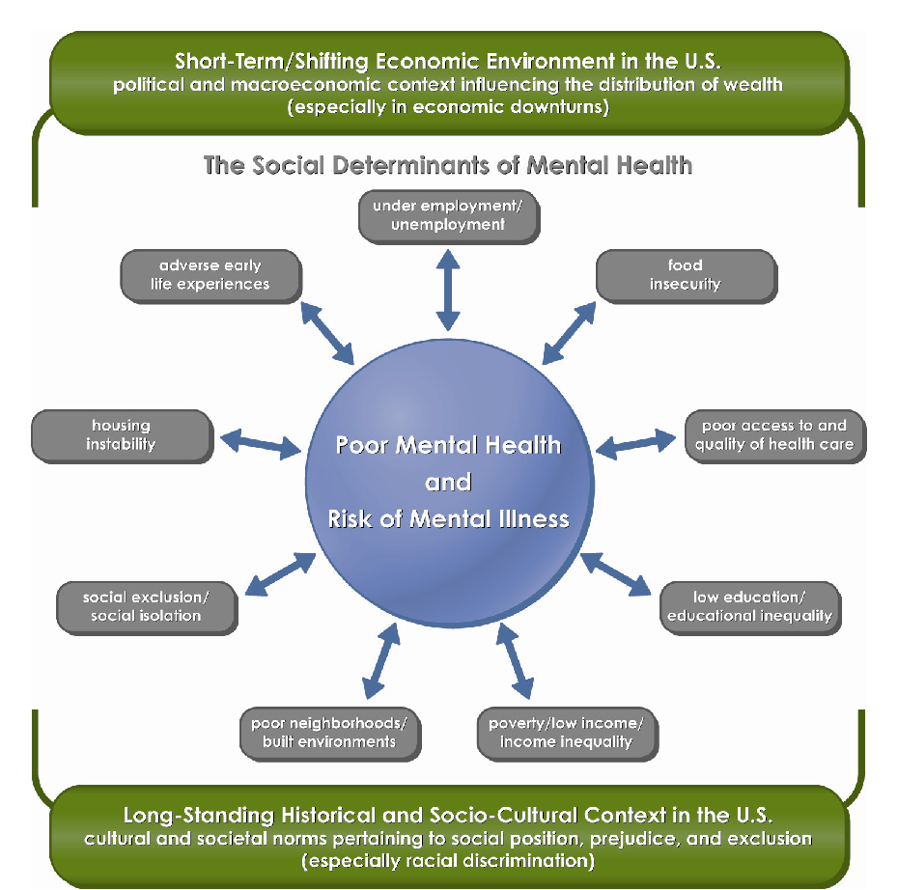
(Compton and Shim, 2015)

Slide 5
Reducing Disparities
Disparities
Adequately Collecting and Using Data
Workforce Diversity/Inclusion
Training Mentoring/Supervision
Cultural Competence, Humility, Addressing Implicit Bias
Policy, Compliance, Regulation
Notes:
Matt

Slide 6
National CLAS Standards - Blueprint for Change
The National CLAS Standards are intended to advance health equity, improve quality, and help eliminate health care disparities by establishing a blueprint for health and health care organizations to:
Principal Standard
Provide effective, equitable, understandable, and respectful quality care and services that are responsive to diverse cultural health beliefs and practices, preferred languages, health literacy, and other communication needs

Slide 7

Questions, Comments, Concerns

Slide 8
Contact
Matt Canuteson, MA
Chief Diversity Officer
Matthew.Canuteson@omh.ny.gov

