Slide 1
A Futureless Man:
The Integration of a Traumatized Life
Eric C. Arauz MLER
Trauma Institute of New Jersey
Adjunct Faculty Instructor
Department of Psychiatry
Rutgers Robert Wood Johnson Medical School
Notes:
Qualia: phenomenal conscious vs intentionality – the representational aspects of mental states

Slide 2
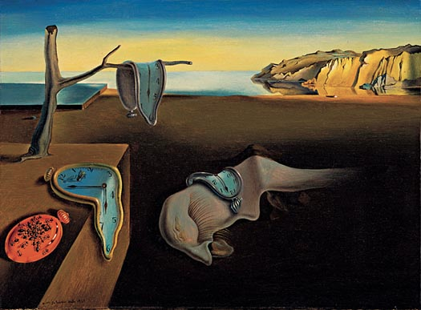
A Futureless Man:
The Integration of a Traumatized Life
Eric C. Arauz MLER
Trauma Institute of New Jersey
Adjunct Faculty Instructor
Department of Psychiatry
Rutgers Robert Wood Johnson Medical School
Notes:
Salvador Dali The persistence of memory Hope Works ACE no dreams
Judith Herman Describes it an endless present
A persistent arousal of predator
No safety
The abstraction of time disallowed for the permanent reactive and reflexive state
Dantes Ninth circle of hell frozen in the hell of self never moving forward or backward alone: observing a past life narrative and a society you cannot reenter like Mokros Humiliated fury
Burning alive from the skin in in a wordless hell

Slide 3
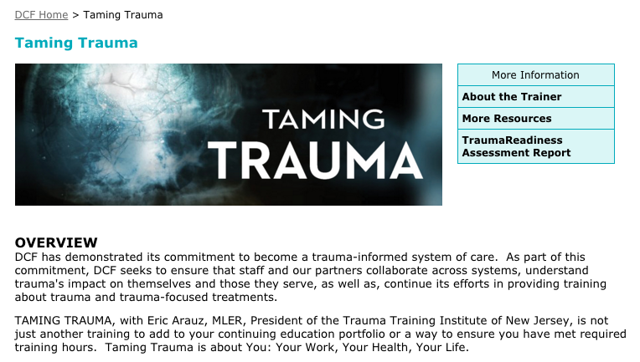

Slide 4
Secondary Traumatic Stress
Therapeutic Workers
“A Persistent Raised Stress Response”
Meta-Analysis of Risk Factors for Secondary Traumatic Stress in Therapeutic Work with Trauma Victims.
Jennifer M. Hensel, Carlos Ruiz, Caitlin Finney, and Carolyn S. Dewa. All out of Toronto, Ontario, Canada. Volume 28, Number 2, April 2015 of the Journal of Traumatic Stress. Published by the International Society for Traumatic Stress Studies.
Notes:
MIRROR NEURONS,,,PEOPLE CANNOT TAKE TOO MUCH the whole lead in….dossocaite….lateral and horitzonatl intergration of the brin
Safety, proximity, intimact and vulerability
Titration
dosing
Prolonged exposure therapy….life…acierno
Trauma narrative….for part two…the case for interventions
Never safe….
Kerry Bastian and the trauma team
You are the caregiver

Slide 5
Adverse Childhood Experiences Study (ACES) 6000+
Physical abuse by a parent
Emotional abuse by a parent
Sexual abuse by anyone
An alcohol and/or drug abuser in the household
An incarcerated household member
Someone who is chronically depressed, mentally ill, institutionalized, or suicidal
Domestic violence
Loss of a parent
Emotional neglect
Physical neglect
Felitti, V. J., Anda, R. F., Nordenberg, D.F., Williamson, D. F., Spitz, A.M., Edwards, V., et al. (1998). Relationship of childhood abuse and household dysfunction to many of the leading causes of death: The Adverse Childhood Experiences (ACE) Study. American Journal of Preventative Medicine, 14(4), 245-258.
Notes:
Felitti, V. J., Anda, R. F., Nordenberg, D.F., Williamson, D. F., Spitz, A.M., Edwards, V., et al. (1998). Relationship of childhood abuse and household dysfunction to many of the leading causes of death: The Adverse Childhood Experiences (ACE) Study. American Journal of Preventative Medicine, 14(4), 245-258.

Slide 6
Risk Factors for Adult Heart Disease are Embedded in Adverse Childhood Experiences
3.5
3
2.5
Odds Ratio
2
1.5
1
0.5
0
1
2
3
4
5,6
7,8
ACEs
Source: Dong et al, 2004

Slide 7
Emotional Basis of Cognition
Abstract
Concrete
Emotional
Reactive
Reflexive
Reactive
Relationship Destroyer
Notes:
MIRROR NEURONS,,,PEOPLE CANNOT TAKE TOO MUCH the whole lead in….dossocaite….lateral and horitzonatl intergration of the brin
Safety, proximity, intimact and vulerability
Titration
dosing
Prolonged exposure therapy….life…acierno
Trauma narrative….for part two…the case for interventions
Never safe….
Kerry Bastian and the trauma team
You are the caregiver

Slide 8
Physiological State Determines Psychological Experience
(Porges SW. The polyvagal theory: phylogenetic substrates of a social nervous system. International Journal of Psychophysiology 42 (2001) 123-146.)
Safety
Danger
Life Threat
Notes:
Somatic and cognitve, teaming inside and out, both experiencing together

Slide 9
Safety Belt: Workforce Interventions

Slide 10
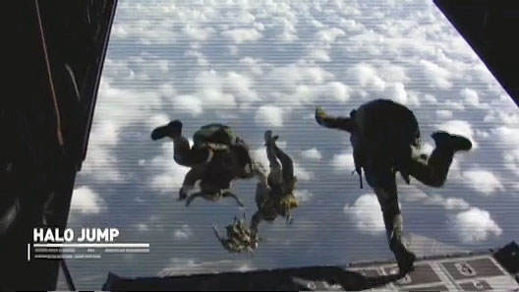
Mutually Therapeutic Dyadic Attunement (MTDA)
The Power and Science of the Relational Milieu
Notes:
DANTE VIRGIL
“patient’s experience of the illness and the doctor’s attention to disease.” Kleinman
http://www.airforce.com/see-what-its-like/

Slide 12
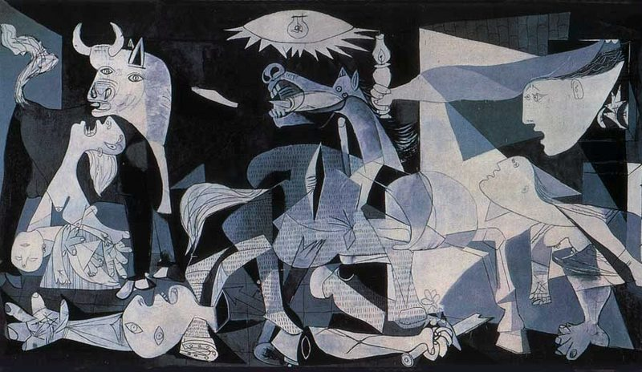
Notes:
CIVILIANS
PICASSO…GUERNICA…BASQUE LANDS….CIVIL WAR….DAD’S…MY FAMILIES…MY OWN….STILL PUTTING BACK TOGETHER….
Disconnection…The numerous diagnosis the fracturing of self…the fracturing of family…fracturing of sanity….fracturing of known systems and known experiences…..feel of the situation ENDLESS PRESENT….WORDLESS….DISJOINTED…BLOWN APART…
The pain and process of pulling this apart..the emotional scar tissue and psyhci fault lines of expericne….Bondaries…

Slide 13
Trauma-Informed Storytelling: Full Reconstruction of Narrative Identity- Visceral, Cognitive, Emotional
Read, Write, Speak
Language As Organizing Paradigm For Implicit and Explicit Memory of Psychosis and Trauma
Exploratory Narrative Processing and Coherent Positive Resolution
(Pais, Jennifer L., (2006) Narrative Identity Processing of Difficult Life Experiences: Pathways of Personality Development and Positive Self-Transformation in Adulthood)
“…self change on the basis of self-overhearing…” (Bloom, H. The western Canon: The Books and School of the Ages. New York: Riverhead books, 1995, 46.)
Notes:
And they are never reduced to their fates; they are more, much more, than what happens to them” Harold bllom pg 56 Canon of Western Civilzation on Shakespeares characters

Slide 14
Neocortex
SAFETY
(CERTAINTY/EFFICACY)
Limbic
Diencephalon
Brainstem
DANGER
(UNCERTAINTY/HELPLESSNESS)
2004 Dr. Bruce Perry Child Trauma Academy; Houston, TX.
Notes:
First time hugged in a 12 step prgram…koshi goruma….through table….deep implicit memoreis….diegestive problems….dissociation from youth….tattoos…years of work…
Shutdown during editing the book…
The human brain has a hierarchical organization. The multiple parallel systems in the brain are organized in various brain regions with the most simple in the brainstem and the most complex in the cortex. While somewhat simplified, it is clear that functional complexity correlates with the organizational complexity of the brain, with the most simple regulatory functions mediated by the lower less complex brainstem and the most complex functions - those functions that confer the most unique human properties - are in the cortex. The human cortex is amazingly complex - rich in both nerve cells (neurons) and functional connections between neurons (synapses). The human cortex contains approximately 40 % of the total neurons in the brain.
A key to understanding human behavior is recognizing the complexity of and the organizational rationale of the brain. Different systems and areas of the brain mediate unique functions. The systems of the brain that allow us to “think” are different (but connected with) the systems that allow us to move or to regulate heart rate.

Slide 15
Trauma-Informed Story Telling
(Bertha Pappenheim: Sigmund Freud and Josef Breuer
Studies on Hysteria)
Effective treatment is a matter of helping individuals keep the observing prefrontal cortex online as it simultaneously experiences the raw primitive sensations generated in the archaic portions of the brain (the limbic system, hypothalamus and brain stem.)
(Levine, P., In An Unspoken Voice. Berkeley: North Atlantic Books,2010, 71.)
Notes:
Addiction Shakespeare Free Artist to Themselves….self overhearing…the universe moving in rea time Static hoplessnes Joiner
Sculpting, pain and process of change, flooding, careful to titrate To exist in realtime
Dan Siegel MD WHAT THE NARRATIVE EXPERIENCE TELLS US IS THAT WHAT IS SHAREABLE IS BEARABLE
Van der kolk, jusy talk therapy alone just

Slide 16
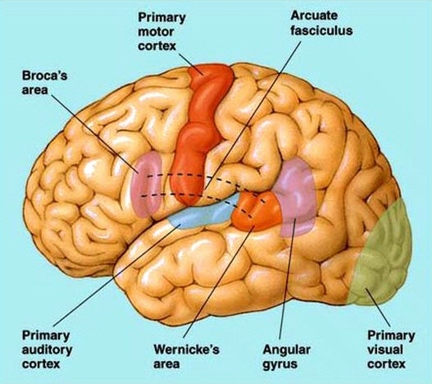

Slide 17
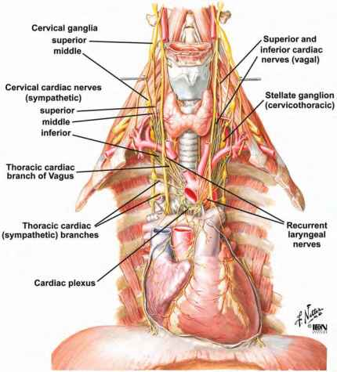

Slide 18
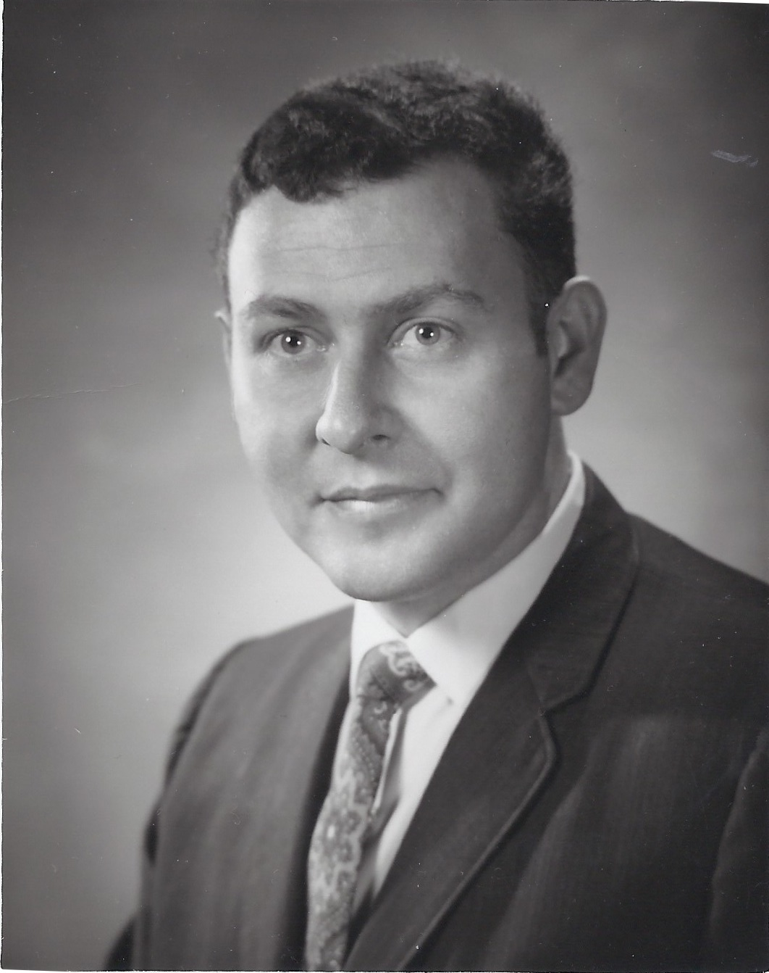
Notes:
….coardice and shame and self hate. My father and my own. Sevice ghettoes, Institutional circuit TL Luhrman Stanford Down and out in Chicago
BRIEF ABOUT HIM, THEN ABUSE MOM, HOUSE MADE ME SICK, CAR IN PARKING LOT, ST BARTS

Slide 19
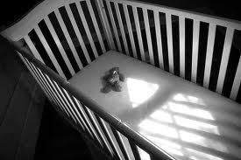
Notes:
My journey
First episode watch the tv, the physical nature,
losing ashley
Kissing her goodbye

Slide 20
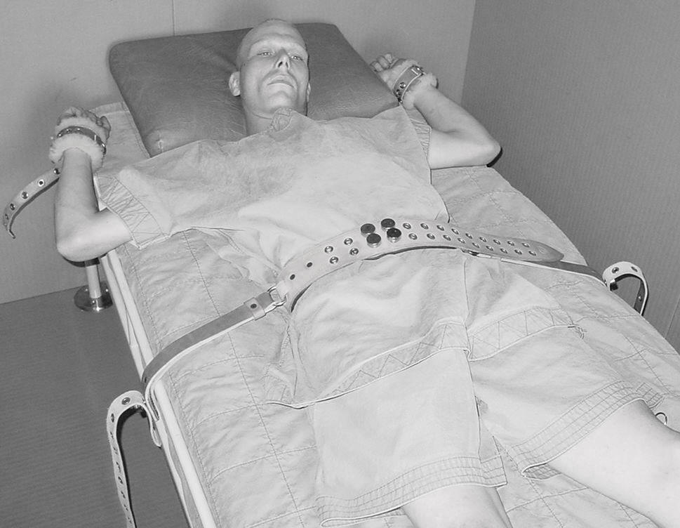
Absolute Shattering of the “Self”
Physiological
Cognitive
Spiritual
Social
Familial
Notes:
Homelessness of trauma
Person in suicide…the actual…the pain of acceptance….clinical
Both of us Addiction, developmental trauma, PTSD restraints, Suicide attempts, serious mental illness, eating disorders
Patient in RelationAL Context
Vs
The Absolute Value of
|Patient|

Slide 21
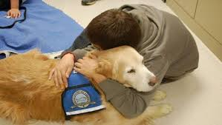
Diagnosis
Bipolar Disorder 1
Addiction
Developmental Trauma
Posttraumatic-Stress Disorder
2 suicide attempts-1 near lethal
Notes:
Which takes precedance. Often the one that can have a pharmaceuical intervention or most lethal

Slide 22
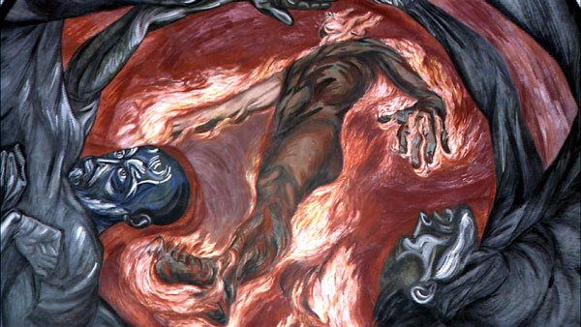
Pain & Process of Transformation
Ideas vs. Beliefs
Notes:
Jose Clemente Orozco Man of Fire

Slide 23
An Integrated Perspective
Bipolar
Alcoholism
Trauma
Suicide
Drug Addiction
Childhood Obesity
ACE
Notes:
Written, Oral
Gendlin Focusing

Slide 24
Recovery as Post-Traumatic growth: Integration and Differentiation of Self

Slide 25
Insights from the Reading
of
1000 ACE Tests
of
Children Welfare Workers
Notes:
Addiction Shakespeare Free Artist to Themselves….self overhearing…the universe moving in rea time Static hoplessnes Joiner
Sculpting, pain and process of change, flooding, careful to titrate To exist in realtime
Dan Siegel MD WHAT THE NARRATIVE EXPERIENCE TELLS US IS THAT WHAT IS SHAREABLE IS BEARABLE
Van der kolk, jusy talk therapy alone just

Slide 26
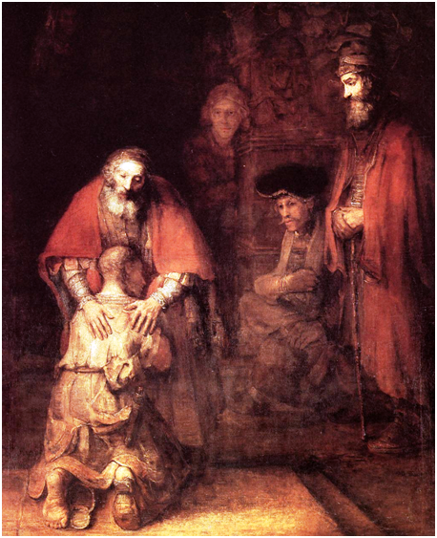
You Must Go On;
I can’t Go On;
I’ll Go On.
Samuel Beckett
The Unamable
Notes:
Addiction Shakespeare Free Artist to Themselves….self overhearing…the universe moving in rea time Static hoplessnes Joiner
Sculpting, pain and process of change, flooding, careful to titrate To exist in realtime
Dan Siegel MD WHAT THE NARRATIVE EXPERIENCE TELLS US IS THAT WHAT IS SHAREABLE IS BEARABLE
Van der kolk, jusy talk therapy alone just

Slide 27
ACE Score
Father
Son
10
9
Notes:
Addiction Shakespeare Free Artist to Themselves….self overhearing…the universe moving in rea time Static hoplessnes Joiner
Sculpting, pain and process of change, flooding, careful to titrate To exist in realtime
Dan Siegel MD WHAT THE NARRATIVE EXPERIENCE TELLS US IS THAT WHAT IS SHAREABLE IS BEARABLE
Van der kolk, jusy talk therapy alone just

Slide 28
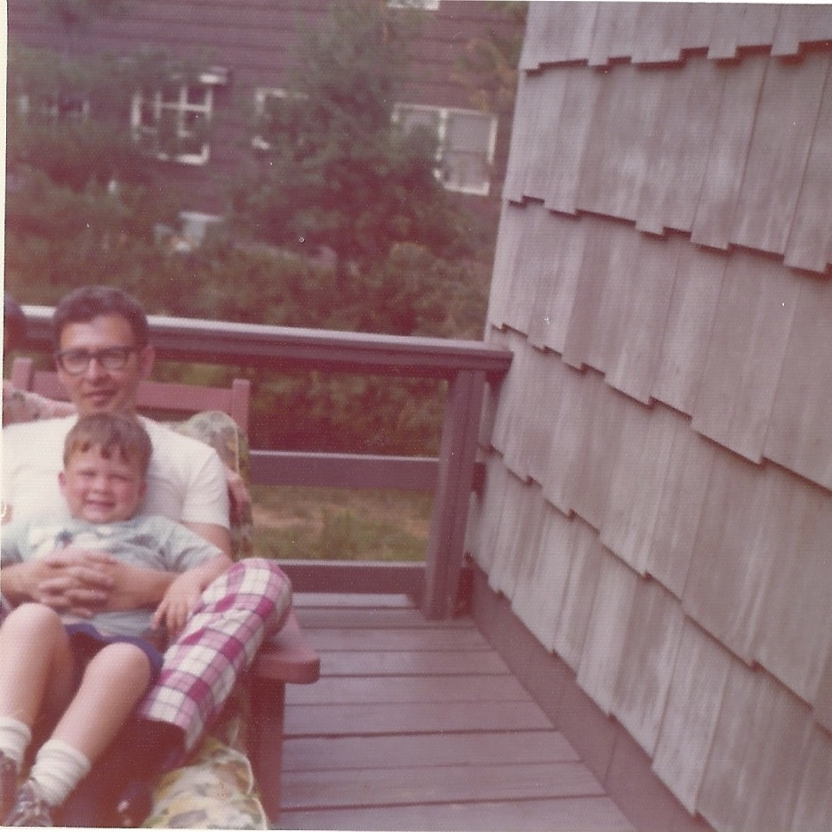
Notes:
98% of traumatized children have traumatized parents
Get sick. Unmylinated vagal response to stomach, digestions,
Untangling: Gendlin from discussion earlier with Perry about how sad the two are

Slide 29
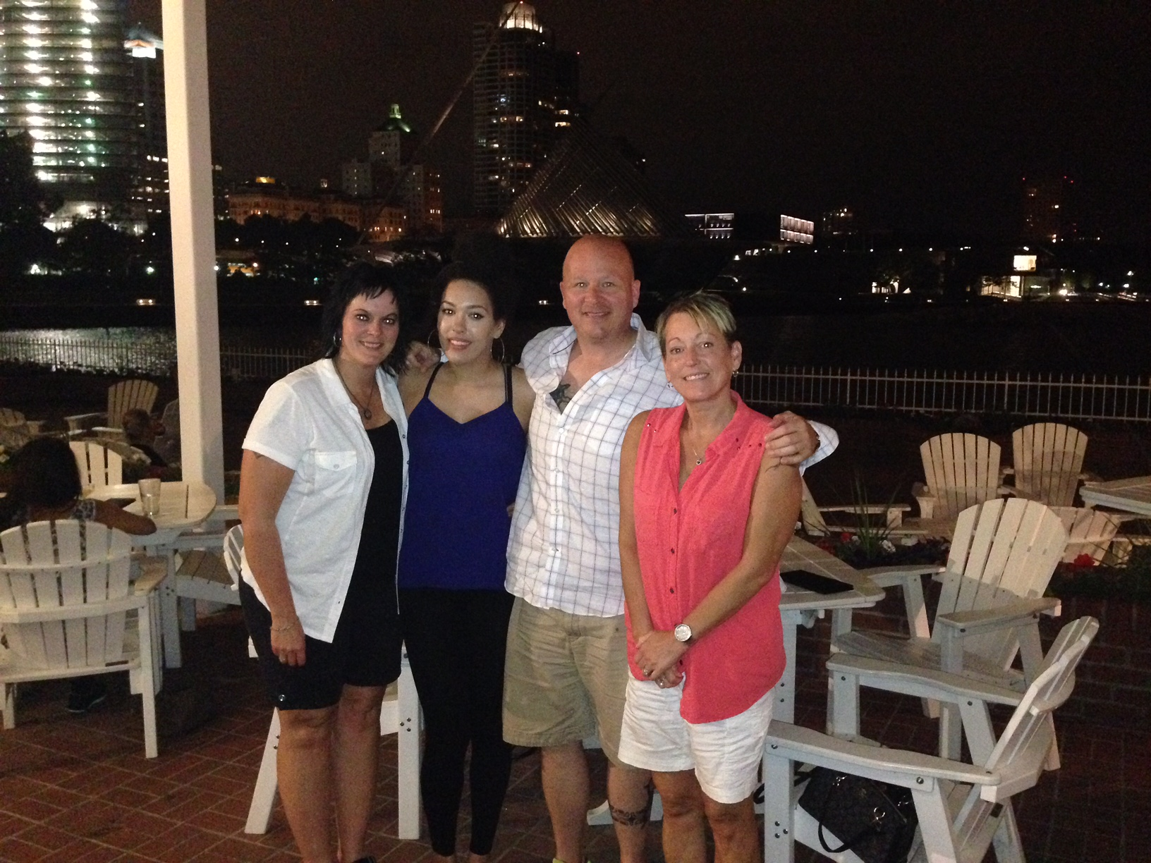
Ashley Picture
Notes:
Qualia: phenomenal conscious vs intentionality – the representational aspects of mental states

Slide 30
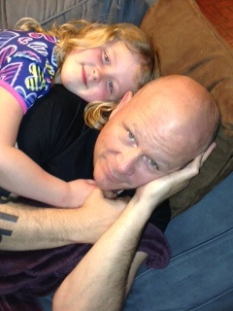

Slide 31
Ace Score
Daughter
0
Notes:
Qualia: phenomenal conscious vs intentionality – the representational aspects of mental states

