Slide 1
Why Connections are Critical for Well-Being
New York State Coalition for Children’s Behavioral Health
Annual Staff Development Training Forum
Saratoga Hilton, Saratoga Springs, NY
November 30, 2016

Slide 2
PRESENTERS
Annette Semanchin Jones, PhD., MSW
Assistant Professor
University at Buffalo School of Social Work
amsemanc@buffalo.edu
Dena Adler, MA, ATR
Hillside Children’s Center
Coordinator, Institute for Family Connections
dadler@hillside.com
Michelle Manley Belge, LMSW
Hillside Children’s Center
Director, Institute for Family Connections
mbelge@hillside.com

Slide 3
Overview
Importance of Youth Connections:
Brief Summary of Current Research
Development of Youth Connections Scale and Newly Adapted Youth Connections Scale-Child Version
Michelle – Implementation
Dena – Bringing the Connection Scale to Life!
Questions and Discussion

Slide 4


Youth Connections and Permanence
Legal Permanence
Relational and Emotional Permanence
  Financial, social and emotional safety net
  Transition to adulthood - Interdependence vs. Independent
  Sense of belonging
References: (Samuels, 2008; Mendes & Moslehuddin, 2006; Bamba & Haight, 2006)
Notes:
Legal permanence, which is defined as the reunification, adoption, or transfer of legal guardianship of the youth, remains a critical goal to achieve for youth in child welfare systems. Ideally, a child’s first placement will be their last before permanency, to avoid subsequent trauma and attachment disruptions. However, in recent years emotional and relational permanence have been introduced as concepts that are equally important. Relational permanence is defined as youth having lifelong connections to caring adults, including at least one adult who will provide a permanent, parent-like connection for that youth (Louisell, 2008). Relational permanence can also be understood as youth experiencing a sense of belonging and a deeper understanding of who they are and how they fit into the world (Samuels, 2009). Relational permanence and belonging may be achieved through legal permanence, but that is not always the case.

Slide 5
Youth Connections and Permanence
Achieving youth permanence
  Permanent placements – placement stability
  Avoid subsequent trauma and attachment disruptions
Connections & Placements with Kin
  Increased placement stability
  Improved behavioral development and mental health functioning
  Maintain ties and connections to their cultural heritage and communities
(See Cochrane review on Kinship Care by Winokur et al, 2014).
Notes:
(promote school stability and connections to other family)

Slide 6

Youth Connections:
Background and Significance
Risk Factors
Youth aging out at increased risk for incarceration, school drop out, poverty, unemployment and homelessness
One fourth of youth are reading at a third grade level or lower when they age out of foster care.
Less than one in five youth are
completely self sufficient when they age out of foster care.
(References: Courtney & Dworsky, 2006; Kerman et al., 2002; Samuels & Pryce, 2008; Massinga & Pecora, 2004; Perry, 2006).
Notes:
Recent studies indicate that youth who age out of care without permanent, parent-like connections experience increased risk for early pregnancy, incarceration, dropping out of school, homelessness, poverty and unemployment (Barth, 1990; Courtney, Piliavin, Grogan-Kaylor, & Nesmith, 2001l Cook, 1994; Courtney et al., 2001; Mallon, 1998). Youth development literature outside of foster care contexts has long identified the benefits for youth of being connected to supportive adults including its positive effects on self-esteem, psychological health, educational achievement, and social skill development (Massinga & Pecora, 2004; Perry, 2006).
Well-Being Outcomes
Recent studies show that youth who age out of care experience increased risk for early pregnancy, incarceration, victimization, and poverty (Barth, 1990; Courtney, Piliavin, Grogan-Kaylor, & Nesmith, 2001).
Many youth who have aged out care have not finished high school, were unemployed, had histories of job instability and on average were paid less than their non-foster youth counterparts (Barth, 1990; Cook, 1994; Courtney et al., 2001; Mallon, 1998).
Many youth experienced instability in housing, with as many as 25% of youth reported being homeless for at least 1 night (Courtney et al., 2001).
risks related to their socio-emotional well being -increased incidence of mental health and behavioral problems, including depression (Barth, 1990). R
recent studies indicate that foster youth report having minimal if any control over maintaining core relationships with those to whom they are attached, most notably siblings, and youth report lack emotional support when leaving care (Samuels & Pryce, 2008).
Youth development literature outside of foster care contexts has long identified the benefits for youth of being connected to supportive adults including its positive effects on self-esteem, psychological health, educational achievement, and social skill development (well-being for some cMassinga & Pecora, 2004; Perry, 2006).
Connectedness
need to maintain connections with kin who can be a crucial resource as youth transition to adulthood (Massinga & Pecora, 2004). Studies have indicated that former foster youth who had some continuity of relationships with significant others, including siblings, foster parents, and biological parents, had better adult developmental outcomes than those who lacked these supports (Kerman et al., 2002).
Transitioning to adulthood is often a long transition process during which young people may leave and return home again on three or more occasions (Mendes & Moslehuddin, 2006). Throughout this process, there is continued availability of the family home as a “safety net” of extended support (Mendes & Moslehuddin, 2006).
Central to understanding ultures, includes finding a place where a person feels a sense of peace, security, satisfaction, acceptance, belonging, and space to be oneself (Bamba & Haight, 2006). Finding a permanency is important for all youth in foster care, but the legal status alone may not provide youth a sense of connectedness and belonging (Bamba & Haight, 2006). When

Slide 7

Youth Connections:
Protective Factors
Youth well-being and success
  Research indicates that youth do better when connected to caring adults:
    Increased resilience
    Increased self-esteem
    Improved mental health
    School success
    Social skill development
(References: Courtney & Dworsky, 2006; Kerman et al., 2002; Samuels & Pryce, 2008; Massinga & Pecora, 2004; Perry, 2006).
Notes:
Connectedness
need to maintain connections with kin who can be a crucial resource as youth transition to adulthood (Massinga & Pecora, 2004). Studies have indicated that former foster youth who had some continuity of relationships with significant others, including siblings, foster parents, and biological parents, had better adult developmental outcomes than those who lacked these supports (Kerman et al., 2002).
Transitioning to adulthood is often a long transition process during which young people may leave and return home again on three or more occasions (Mendes & Moslehuddin, 2006). Throughout this process, there is continued availability of the family home as a “safety net” of extended support (Mendes & Moslehuddin, 2006).
Central to understanding well-being for some cultures, includes finding a place where a person feels a sense of peace, security, satisfaction, acceptance, belonging, and space to be oneself (Bamba & Haight, 2006). Finding a permanency is important for all youth in foster care, but the legal status alone may not provide youth a sense of connectedness and belonging (Bamba & Haight, 2006). When

Slide 8

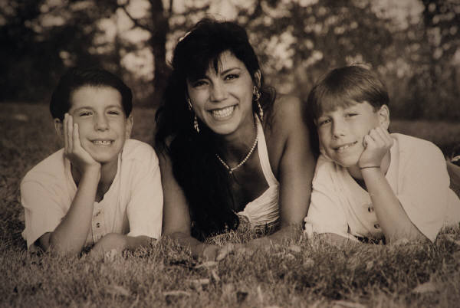
Development of Original
Youth Connections Scale (YCS)
Agency/University Collaboration
Assess and evaluate efforts around relational permanence for youth as they transition to adulthood
No tools existed
Experts in field consulted in development of the Youth Connections Scale
  Social workers, supervisors and administrators of Anu Family Services and other private and public child welfare agencies
  Casey Family Services, Search Institute’s 40 Assets, Foster Club
Notes:
The development of the Youth Connection Scale was part of a larger University-Agency collaborative between the University of Minnesota and Anu Family Services, in which we examine a number of pressing issues around permanence and wellbeing for youth in child welfare.
Experts in the field were consulted in development of this scale, including social workers, supervisors and administrators of public and private child and youth serving agencies, and researchers and scholars in child welfare.
Specifically, items such as the Support Indicators within the YCS were informed by existing practice tools, such as the Permanency Pact, which was developed by young people from FosterClub (2006); the BEST tool developed by Casey Family Services* and the Search Institute’s 40 Developmental Assets.

Slide 9
Development of Original
Youth Connections Scale (YCS)
Developed to measure of youth connectedness for youth in out-of-home placements – ages 15 to 21
100 Point Scale consists of four sections which measure:
  number of connections
  strength of those connections
  types of supports
  overall level of connectedness of foster youth to caring and supportive adults
Pilot study with youth in foster care (n=53) to assess validity and reliability of tool – results were promising
Notes:
The Youth Connections Scale was developed based on the review of the literature on the importance of youth connections to caring adults. Research indicates that the benefits for youth of being connected to supportive adults include positive effects on self-esteem, psychological health, educational achievement, financial stability and social skill development. Connecting foster youth to supportive adults and creating a financial and emotional safety net is particularly critical during the late adolescence, as youth begin to transition to adulthood. The goal of this project is to develop a standardized tool that can be used and disseminated for wider use in child welfare practice.
The development of the Youth Connection Scale was part of a larger University-Agency collaborative between the University of Minnesota and Anu Family Services, in which we examine a number of pressing issues around permanence and wellbeing for youth in child welfare.
Experts in the field were consulted in development of this scale, including social workers, supervisors and administrators of public and private child and youth serving agencies, and researchers and scholars in child welfare.
Specifically, items such as the Support Indicators within the YCS were informed by existing practice tools, such as the Permanency Pact, which was developed by young people from FosterClub (2006); the BEST tool developed by Casey Family Services* and the Search Institute’s 40 Developmental Assets.

Slide 10
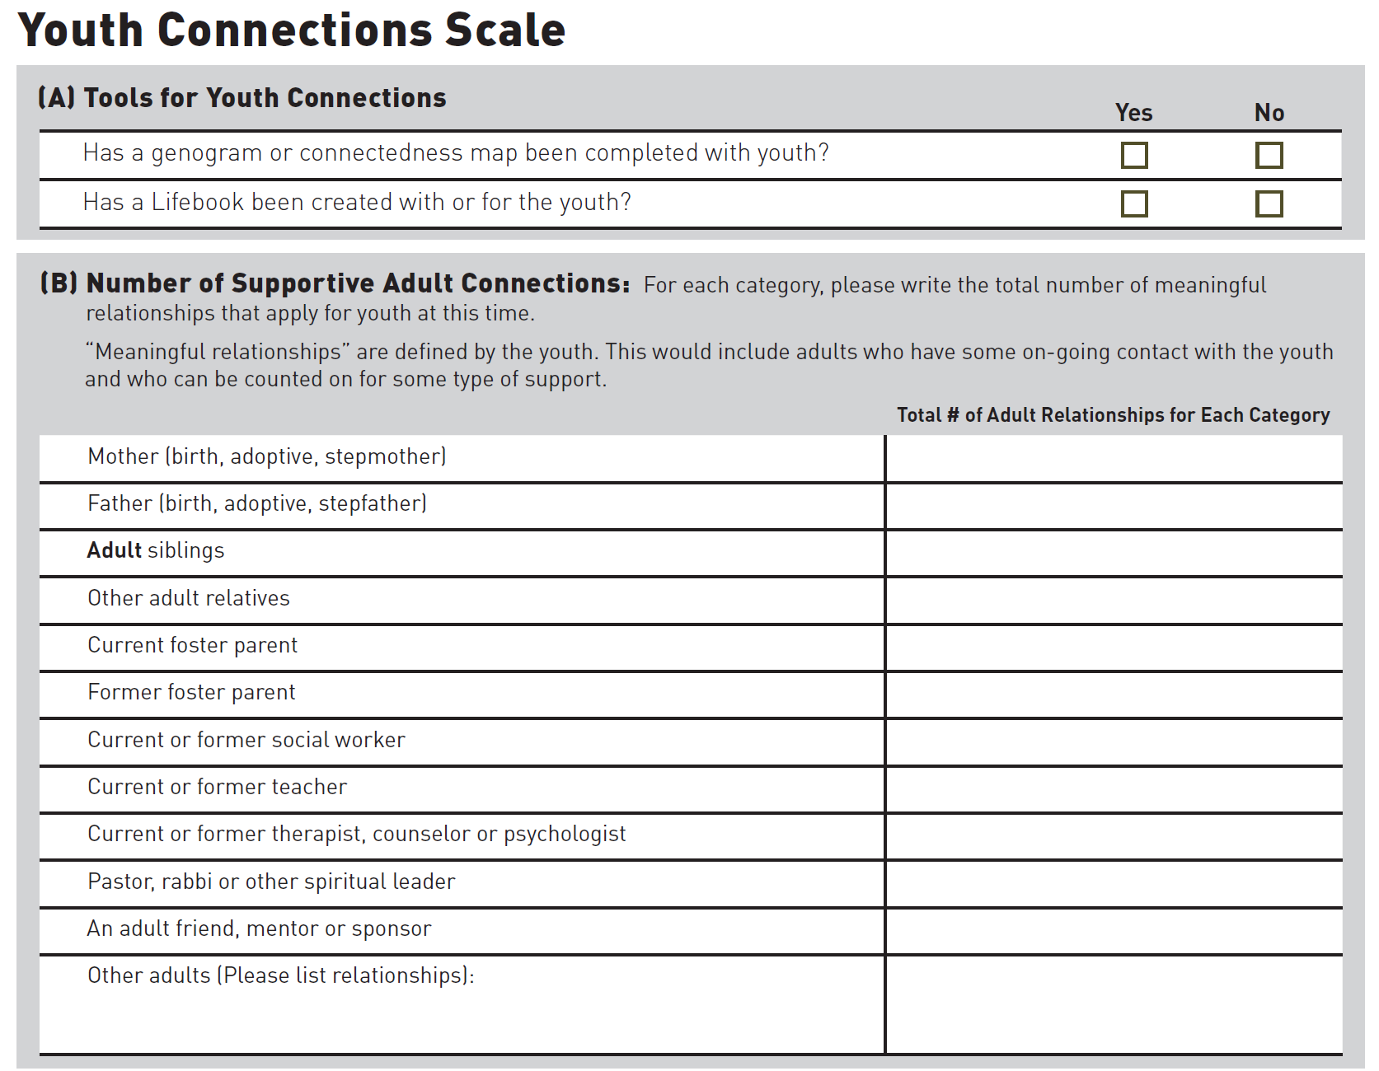
Notes:
Section A: Tools for Youth Connections
This tool was developed with an agency that uses these tools quite often. If you have not done a genogram, ecomap or lifebook with the youth, simply ask the youth to mark “No” in this section, rather than leave it blank.
Section B: Number of Supportive Adult Connections
For this section, the youth is asked to write down the number of meaningful connections in each category. The youth can determine which adult relationships they have are meaningful, but you can help them think about adults that they have some regular contact with and those adults they can really count on for some type of financial, emotional or social support. For example if the youth had a meaningful connection to his biological mother and a stepmother, he or she would write 2 in the first row. If there are other adults that do not meet any of the listed categories, the youth can add their names in the last row, and write the number for this group of adults in the last column.
This tool is meant to measure positive and supportive relationships with adults. If youth are identifying adults who are not supportive (such as a pimp or an abusive relationship), this provides an opportunity for the worker to have deeper discussion about what is meant as a caring and supportive relationship. One key role for the worker is to help the youth talk through (not debate or direct the youth) and think about those important relationships that may not be supportive and healthy connections. In using this tool for discussion, the worker can also help to normalize the feelings of ambivalence, grief and loss that the youth may be experiencing as they think about important adults in their lives.

Slide 11
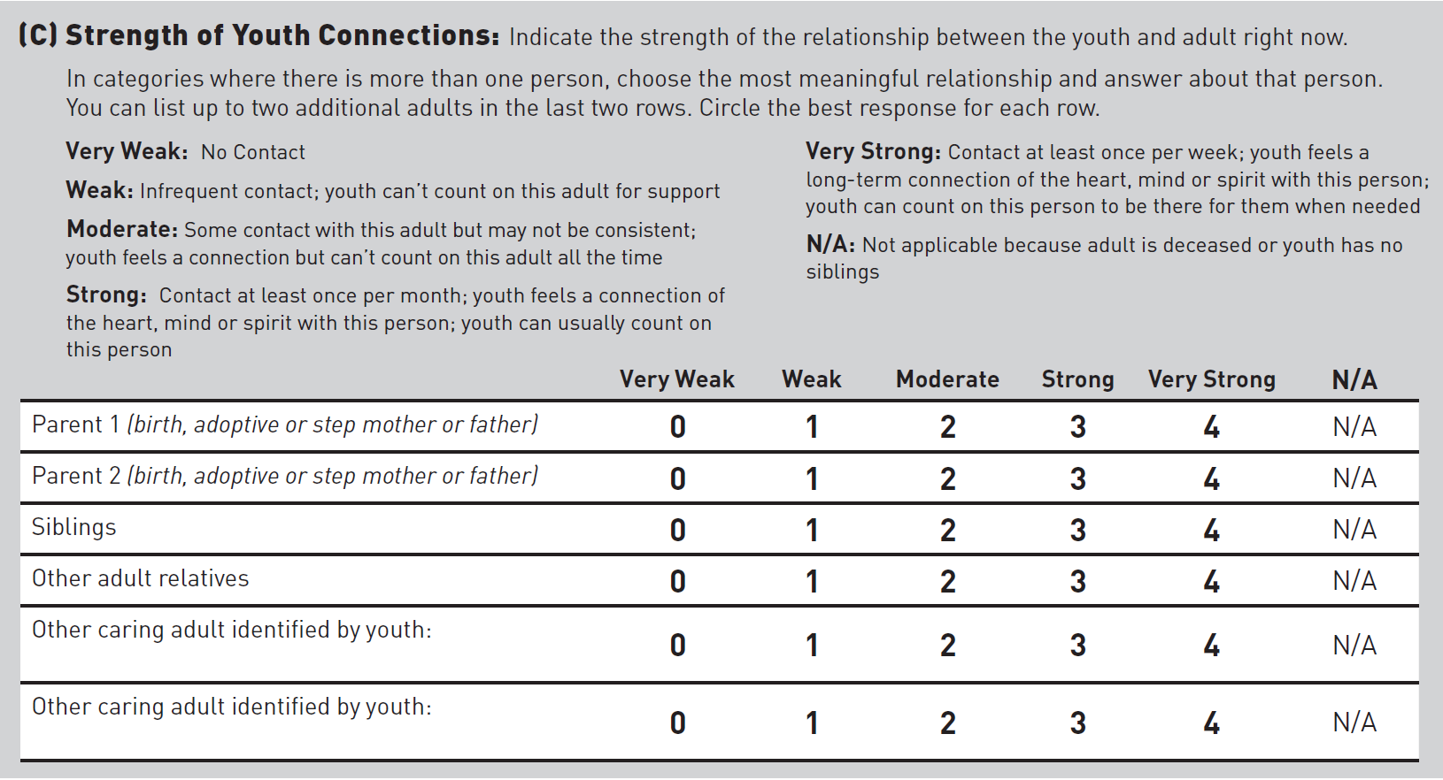
Youth Connections Scale
Notes:
Section C: Strength of Youth Connections
In this section, we are asking youth to think about one person in each of the listed categories (mother, father, siblings, and other adult relatives). If the youth has more than one person in the category, such as biological mother and stepmother, the youth should pick the most significant relationship and answer for that person. If they choose, they could write-in the other person in the final two rows of “other caring adults.” In this section, N/A or not applicable, should only be used if the adults are deceased or if they have no known siblings or other relatives.

Slide 12
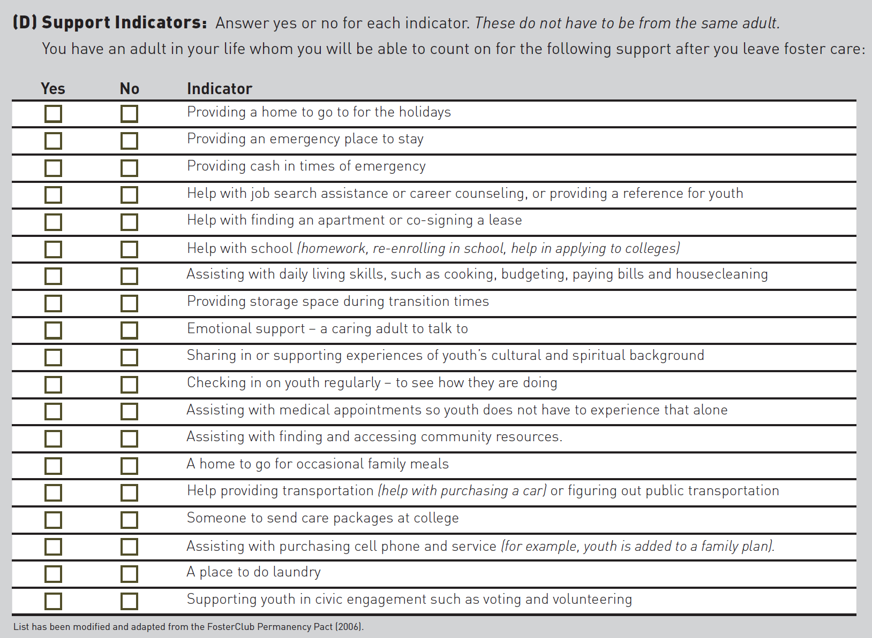
Youth Connections Scale
Notes:
Section D: Support Indicators
For this section, the youth should think about adults in their life that would provide each type of support after they leave foster care. This might include a current foster parent, but only if that person would likely provide that type of support after the youth is discharged from foster care. The types of support do not all have to be from the same caring adult. Encourage the youth to really think about this section realistically – to include the types of support they really think they will be able to count on after foster care. The youth should check yes or no for each indicator.

Slide 13
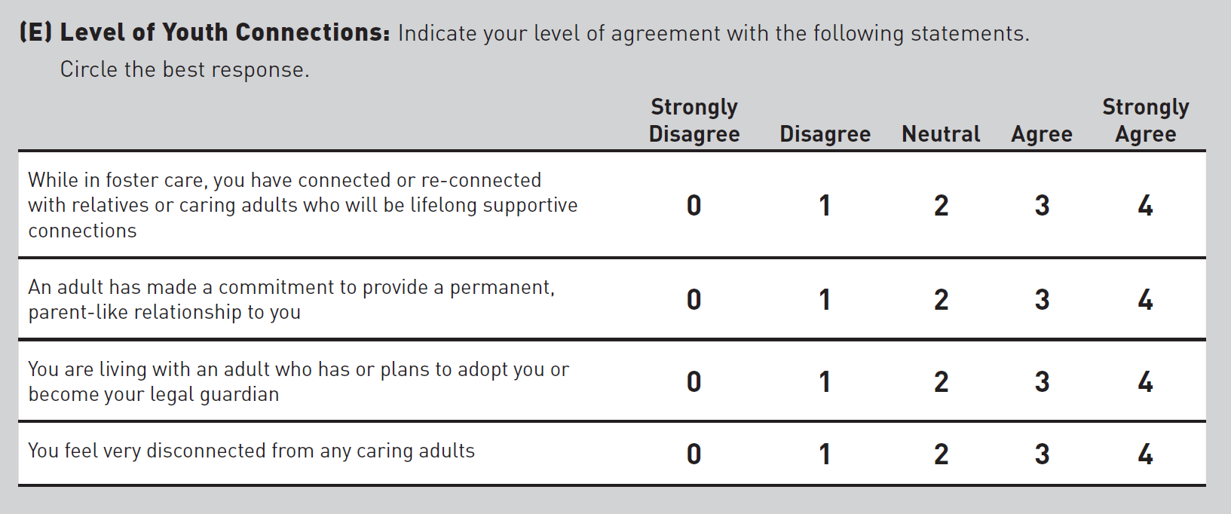
Youth Connections Scale
Notes:
Section E: Level of Youth Connection
For this section, the youth should circle the best response to each of the four statements. If a youth has a legal guardian, but is not living with them, they might agree with the second statement (an adult has made a commitment to provide a permanent, parent-like connection); but disagree with the third statement (youth is living with an adult who plans to adopt or become legal guardian).

Slide 14
Recent Study: Adapting the YCS
Agencies working with youth of all ages – measure connections for younger youth too
Partnered with Hillside Family of Agencies to adapt the tool: Youth Connections Scale – Child Version (YCS-C)
Conducted a similar pilot study to assess the validity and reliability of the newly adapted tool
  Concurrent validity
  Test-retest reliability

Slide 15


Pilot Study: YCS-C
Sampling
Recruited from several programs at Hillside: foster care, therapeutic foster care, and residential programs
Inclusion criteria:
  Children/youth currently in one of these out-of-home placements at the agency
  Age 9 to 14
  Youth were cognitively able to complete survey (as determined by youth’s worker and their supervisor)

Slide 20
Findings of Pilot Study
  Results of data analysis are promising
  Test of Reliability: statistically significant and strong correlation (r=.83, p<.001)
  Test of Validity: tested correlation between Section E of YCS-C (overall connectedness) and the Social Support Scale for Children - statistically significant and moderate correlation (r=.39, p=.001)
  Content validity: 83% of the workers stated that the responses were accurate and valid (rated as 7 or higher on a 10-point Likert-type scale).
Notes:
Qualitative responses YCS-C:
“Youth put thought into the questions and asked clarifying questions when necessary.”
“Client was confident in her answers. Having detailed knowledge of this family, her responses were accurate.”
“Youth's answers closely reflect his experience.”

Slide 21


Implications: Implementation of YCS-C
Service and case planning
  Use with youth early in case
  Identify areas of strengths and areas for increased attention
  Better understand youth’s perception of connections
  Supervision tool – focus efforts in this area
Evaluation and outcome purposes
  Pre and post test
  Compare total scores
  Evaluate subscale scores
Implementation considerations:
  Need training – worker and youth together
  Snapshot of youth’s perspective

Slide 22
Use of YCS at Hillside
Children in out-of-home placement
  Foster Care
  Residential
Community Based Programs
  Family Finding
  Wendy’s Wonderful Kids
  Waiver
  Other

Slide 23

What does every youth need most?
Unconditional Commitment and Love!!!

Slide 24

Connections and Well-Being
Loneliness and disconnection are dangerous to youth, both in the short and long term.

Slide 25

Circles of Support and “The Rest of the Story”

Slide 26

What makes a connection integral and sustainable?

Slide 27

7 ELEMENTS OF CONNECTION
Identity
Integrity
Compassion
Courage
Circle
Community
Unity

Slide 28
capacity for connectedness
Involves a self-discovery process of identity and integrity and courage.
“courage to keep one’s heart open in those very moments
when the heart is asked to hold more than it is able.”
Parker J. Palmer

Slide 29
THE CIRCLE WAY
“We have the power to affect the future of humankind
with every interaction we have with a child.”
“Give them an experience of understanding and compassion
to strengthen and illuminate their journeys through life.”
“It takes a village to raise a child, and it takes a community to be heard and begin to effect change.”
Manitonquat (Medicine Story)

Slide 30
Narrative Collective Practice
“enabling a sense of unity as a person for individuals
whereby a person’s skills or values in the present
become linked to personal and familial history.”
“to generate a sense of unity, of identity with one’s past and future for collectives of people.”
David Denborough

Slide 31

Narrative Collective Practice
“Outsider Witness

Slide 32
We connect with the stories of others; listen and respond as a witness
Which expressions caught your attention?
What was evoked in you?
What did the expressions suggest to you about
other’s purposes, values, hopes and dreams?
How have you been personally moved on account
of bearing witness to the story?

Slide 33


Slide 34
References
Barth, R. (1990). On their own: The experiences of youth after foster care. Child and Adolescent Social Work, 7, 419–440.
Charles, K., & Nelson, J. (2000). Permanency Planning: Creating Life Long Connections. What Does It Mean for Adolescents? . Retrieved May 23, 2012, from http://www.nrcys.ou.edu/PDFs/Mono.pdf.
Courtney, M.E., Piliavin, I., Grogan-Kaylor, A., & Nesmith A. (2001). Foster youth transitions to adulthood: A longitudinal view of youth leaving care. Child Welfare, 80, 685–717.
Daining, C., & DePanfilis, D. (2007). Resilience of youth in transition from out-of-home care to adulthood. Children and Youth Services Review, 29(9), 1158-1178
Foster Club. (2006). For more information on the Permanency Pact see http://www.fosterclub.com/_transition/article/permanency-pact.
Frey, L., LeBeau, M., Kindler, D., Behan, C., Morales, I. M., & Freundlich, M. (2012). The pivotal role of child welfare supervisors in implementing an agency's practice model. Children and Youth Services Review(0).
Geenen, S., & Powers, L. E. (2007). Tomorrow is another problem: The experiences of youth in foster care during their transition into adulthood. Children and Youth Services Review, 29(8), 1085-1101.

Slide 35
References
Hook, J. L., & Courtney, M. E. (2011). Employment outcomes of former foster youth as young adults: The importance of human, personal, and social capital. Children and Youth Services Review, 33(10), 1855-1865.
Lenz-Rashid, S. T. (2009). Developing Permanent, Supportive Connections While in Care: Foster Youth’s Perspectives. Retrieved May 21, 2012, from https://alamedasocialservices.org/opg/documents/PermanencyRptSept2009.pdf
Louisell, M.J. (2008). Six Steps to Find a Family: A Practice Guide to Family Search and Engagement (FSE). National Resource Center for Family-Centered Practice and Permanency Planning; Hunter College & California Permanency for Youth Project. Retrieved online on June 17, 2009 from http://www.hunter.cuny.edu/socwork/nrcfcpp/downloads/SixSteps.pdf
Massinga, R., & Pecora, P. J. (2004). Providing better opportunities for older children in the child welfare system. The Future of Children, 14(1), 151−173.
Mendes, P., & Moslehuddin, B. (2006). From dependence to interdependence: towards better outcomes for young people leaving state care. Child Abuse Review, 15(2), 110−126.
Perry, B. L. (2006). Understanding social network disruption: the case of youth in foster care. Social Problems, 53(3), 371−391.
Samuels, G. M. (2009). Ambiguous loss of home: The experience of familial (im)permanence among young adults with foster care backgrounds. Children and Youth Services Review, 31(12), 1229-1239.

Slide 36
References
“The Heart of a Teacher”: Parker J. Palmer, (www.CourageRenewal.org)
The Joy of Caring for Children in the Circle Way: Manitonquat (Medicine Story) 2015
Collective Narrative Practice: David Denborough 2008

Slide 37
Questions and Comments
Thanks!

